Slide 1
Kings of Dominia
Alexander Schuster, Mengdi Wang ,
Mohamed Haddej, Alexander Epple

Slide 2

Trailer

Slide 3
Game Overview
Titel: Kings of Dominia
Platform: Android/iOS & Windows
Genre: Puzzle / Strategy
Rating: FSK 0
Target: Casual Gamer

Slide 4
High Concept & Unique Selling Points
Multiplatform support (Android/iOS/Windows)
Unique concept (modern Domino game)
Easly expandable (free/paid DLCs)

Slide 5
Game Objectives & Game Rules
Goal:
Bring the enemy king to fall by placing Domino rows and using upgrades strategically
Rules:
Place unlimited normal stones on flat surfaces
Upgrade a limited amount of placed stones
Start the attempt knocking over your king
Use cannons and gates by letting a stone fall on the respective activation pad

Slide 6
Game Controls
Turn and move the camera with two fingers
Switch between the view and edit mode by clicking the respective button
Place Domino rows by drawing on the level
Upgrade a Domino by holding down on it
Turn cannons by holding down on them
Start the attempt by clicking on the king
Reload the level and undo an action by clicking the respective buttons

Slide 7

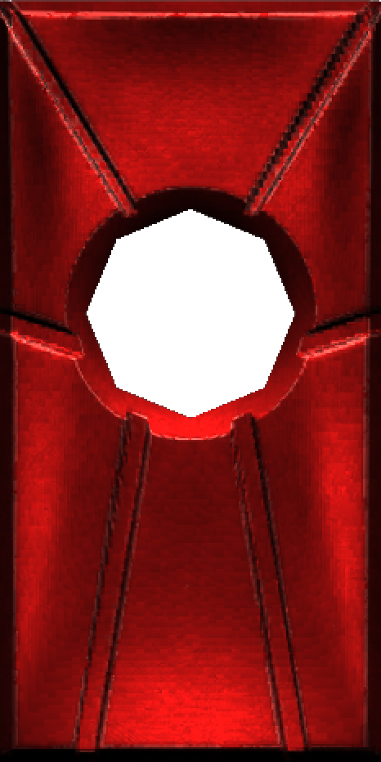
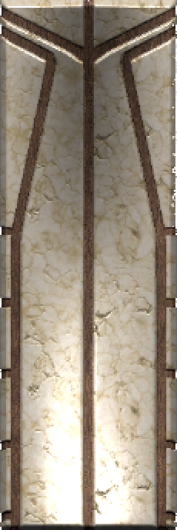
Stone Types
Ice Mage
Pyro
Warrior
Slides once it falls in the falling direction, can pass stairs
Blows up walls that it touches, causes a big shockwave
Can reach farther as well as hit objects like boulders harder

Slide 8
Project Plan Part 1: Work Division
 | Prototype | Presentation & Pitch
Alex E | Programming, Debugging | Game design, Story, Trailer
Alex S | Art Modelling | Cost, Break-Even, Marketing, Pricing
Mengdi | Programming, Debugging | Project Plan, Publishing, Trailer
Taieb | Sound Effect

Slide 9
Project Plan Part 2: Platform & Tools
Communication
Face-To-Face
Whatsapp
Discord
Prototype Platform
Unity
Source Control
Github Plug-In for Unity

Slide 10
Project Plan Part 3: Time Estimation
Before our project starts…
 | Estimated Time | Deadline
Idea & Concept | 3 weeks | 20.11.2017 (4th Seminar)
Game Mechanic | 1 week | 27.11.2017 (5th Seminar)
First playable Level | 4 weeks | 24.12.2017 (Chrismas)
All Models added |  | 24.01.2018
All Sound Effect added |  | 24.01.2018
UI finished | 2 weeks | 24.01.2018
All Levels finished | 4 weeks | 25.01.2018
Game Build successful | 1 day | 26.01.2018

Slide 11
Project Plan Part 3: Time Estimation
When it really starts…
 | Finished Time | Overdue?
Idea & Concept | 27.11.2017 | Yes ☹
Game Mechanic | 28.11.2017 | Yes ☹
First playable Level | 05.12.2017 | No ☺
All Models added | 21.12.2017 | No ☺
All Sound Effect added | 22.01.2018 | No ☺
UI finished | 15.01.2018 | No ☺
All Levels finished | 21.01.2018 | No ☺
Game Build successful | 24.01.2018 | No ☹

Slide 12
Project Plan Part 4: Action List (real)
Action | Date | Notes
1. Team Set Up | 23.10.2017 | 1st Seminar
2. New Member | 06.11.2017 | 2nd Seminar
3. Kick-Off 1 | 27.11.2017 | Game Idea confirmed
4. Level Design | 16.01.2018 | Two more Level Designs
5. Trailer | 25.01.2018 | Trailer finished
6. Presentation | 06.03.2018 | Presentation finished

Slide 13
Project Plan Part 5: Milestones (real)
Milestones | Date | Notes
1. Kick-Off 2 | 28.11.2017 | Game mechanic confirmed
2. First Commit | 03.12.2017
3. New Models | 04.12.2017
4. First Test Level | 05.12.2017 | First playable Level
5. Domino Spawn | 07.12.2017 | Drag spawns Domino
6. Edit Mode | 15.12.2017
7. Line Renderer | 15.12.2017 | Spawn shows line
8. Camera Function | 17.12.2017
9. New Domino Type | 18.12.2017 | Ice Domino added

Slide 14
Project Plan Part 5: Milestones (real)
Milestones | Date | Notes
10. Reverse Mechanic | 18.12.2017 | Game Reverse Framework
11. Basic UI | 19.12.2017 | Primary UI added
12. Sound Effect | 21.12.2017
13. UI Refinement | 15.01.2018 | UI finished
14. New Domino Type | 17.01.2018 | Pyro Domino added
15. New Levels | 21.01.2018 | New Designs realized
16. Model Refinement | 22.01.2018 | All Models finished
17. Vibration | 24.01.2018 | Vibration added
18. Project Build | 24.01.2018 | Prototype finished! ☺

Slide 15
Project Plan Part 6: Future
Since our prototype is already finished, we could imagine what if we start up as a real indie team right now?
Team Reinforcement
At least one more dedicated Designer (Artist)
At least two more Programmers
Team Leader (Project Manager)
Nice-To-Have: Assistant (Marketing, Publishing, etc.)

Slide 16
Project Plan Part 6: Future
Imaginary Time Estimation
 | Estimated Time
New Game Concept & Story | 1 week / maybe not
Game Mechanic Refinement | 3 weeks
Target Group Analysis | 1 week
First Test Level | 3 weeks
Game Design Refinement | consecutive
First playable Beta Level | 4 weeks
All Levels playable | 4 weeks
Level Beatufication | 2 weeks
All done before get into Market | ???

Slide 17
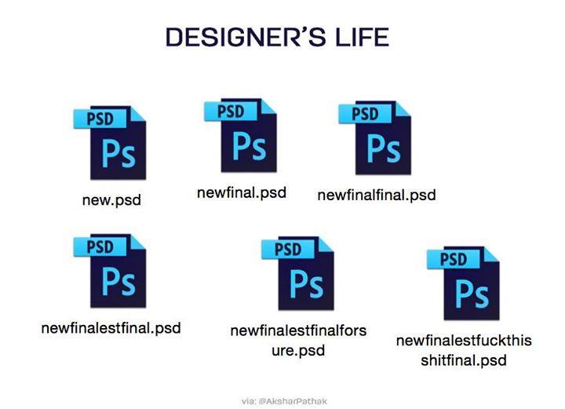
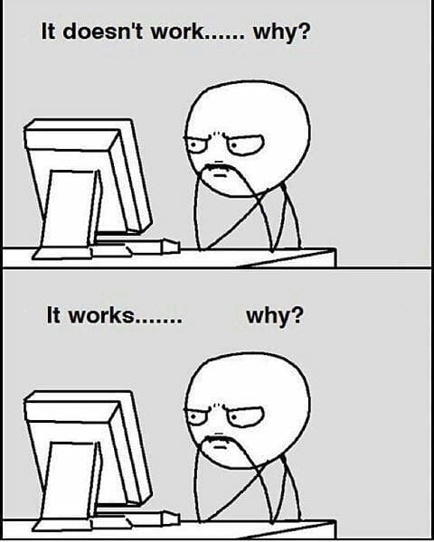
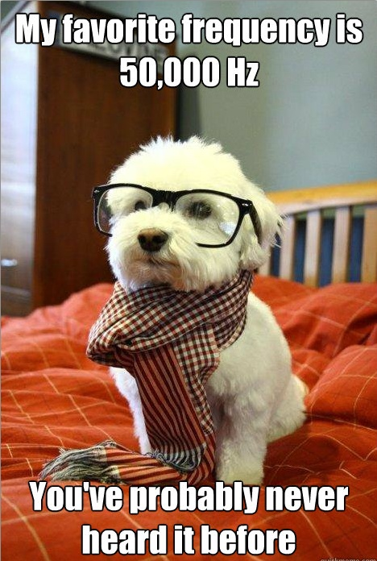
Kosten
Fixkostenschätzung
2x Programmierer
1x Audio Engineer
1x Art Designer
Gehalt von 2900 bis 4000 Geld (wir nehmen 3500) => 3.500$ x 4 = 14.000$ pro Monat
Unity Plus: 35$ x 4 = 140$ pro Monat

Slide 18
Kosten
Sprungfixkosten/ variable Kosten
Synchronsprecher für Vertonung der Story
Art Designer -> zusätzliche Skins oder Levels
Ggfs. Mac System
Apple Developer Account
Nice-To-Haves

Slide 19
Kosten
Zeiteinschätzung
Best Case | 2 Monate
Most Likely | 3,5 Monate
Worst Case | 6 Monate
Aufwandschätzung: 1/6 x (2x2 + 3x6 + 3,5) = 4,25 Monate
Gesamte Fixkosten: 4,25 x 14.140$ = 60.095$

Slide 20
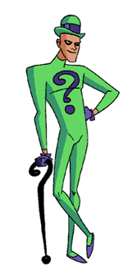
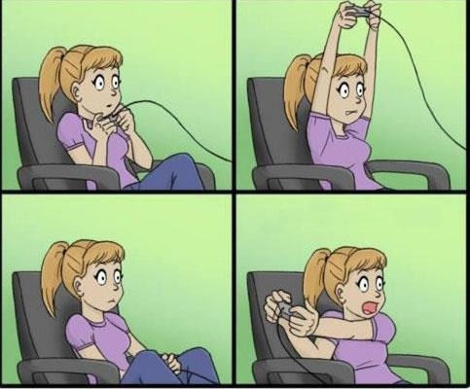
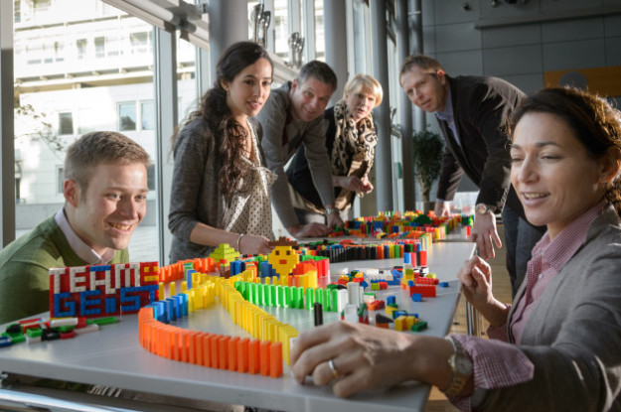
Marketing
Zielgruppe
Casual Gamer
puzzler
Domino Fans
Herausforderung: beide Zielgruppen anwerben

Slide 21
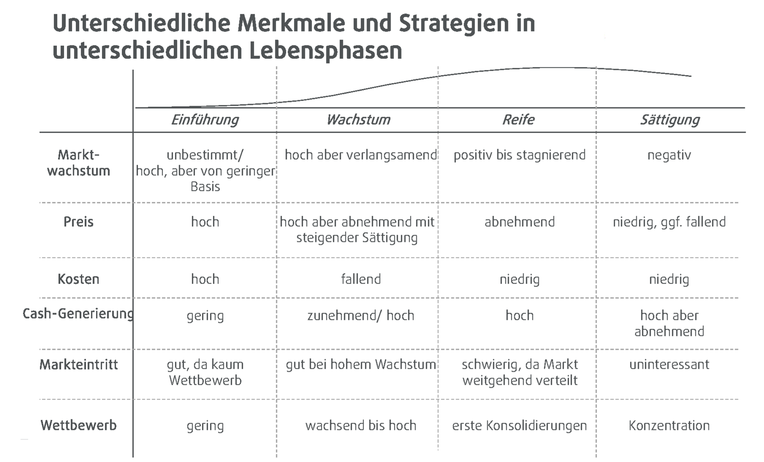

Slide 22
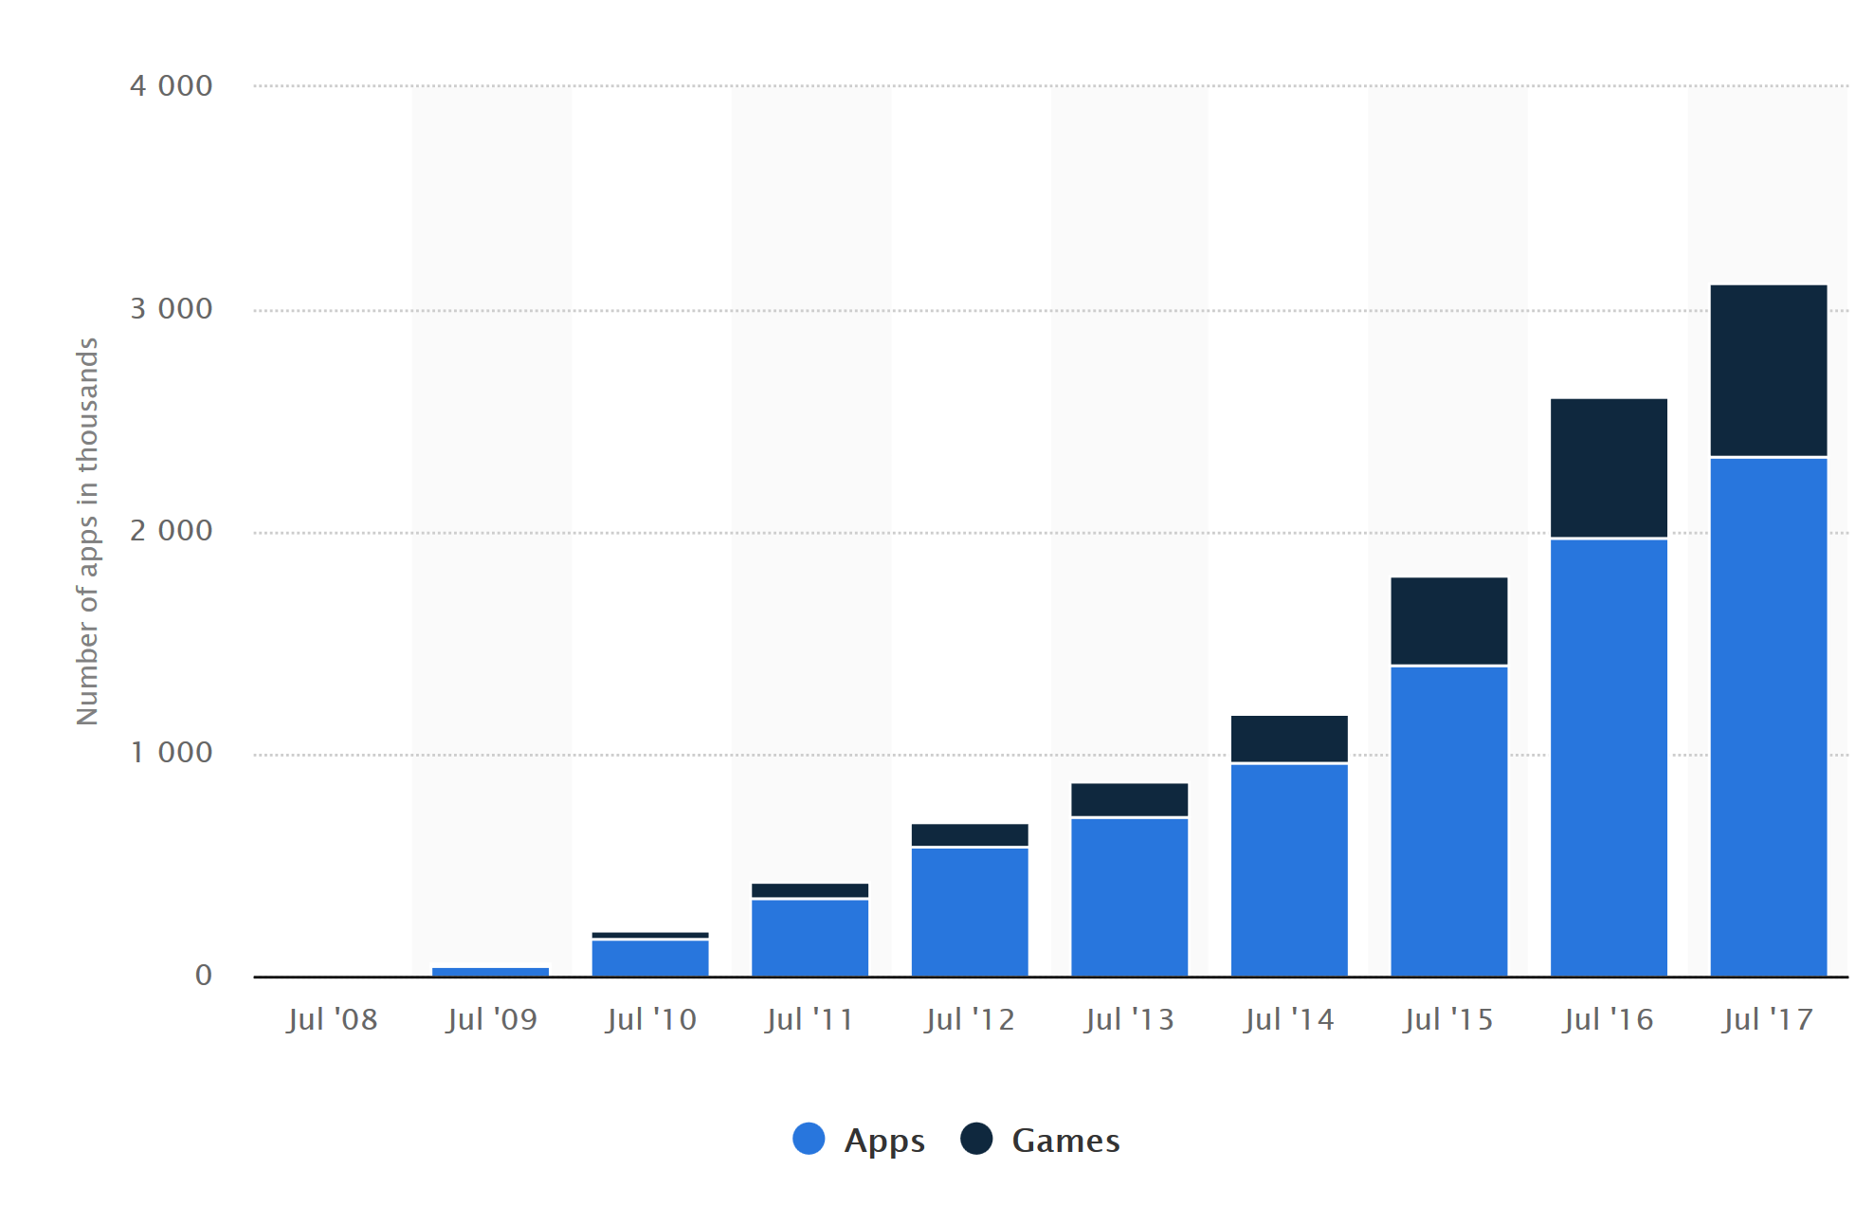
Marketing
Apple Appstore

Slide 23
Marketing
Unique Selling Points
Publisher:
geringe bis keine Anschaffungskosten
Bei Erfolg Spieleinhalt ohne zusätzliche Fixkosten erweiterbar
Cross Plattform
Graphik (gegenüber Konkurrenz + Theme Immersion)
Spieler:
Einzigartiges Spiel (Domino Genre extrem klein)
Nostalgiefaktor für Domino Fans
Cross Platform

Slide 24
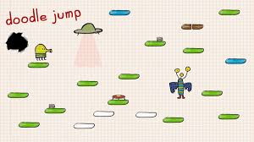
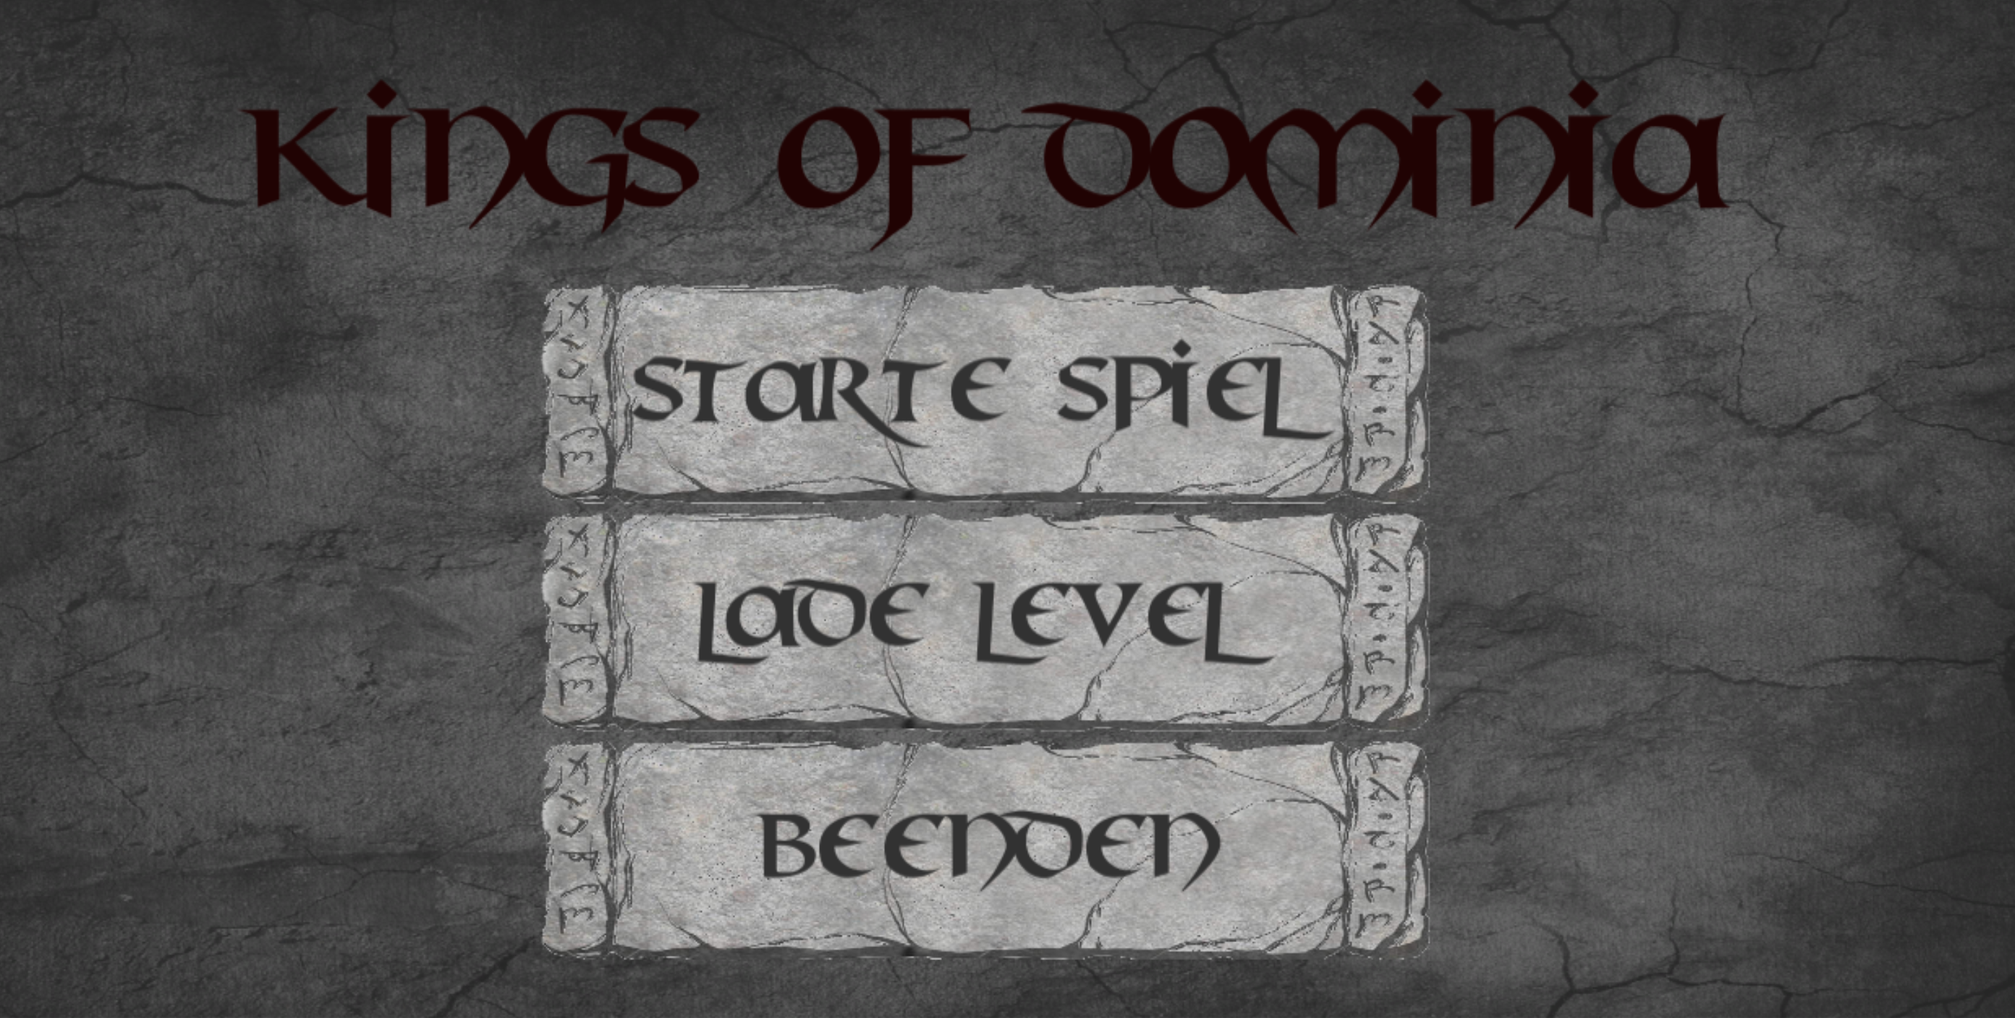
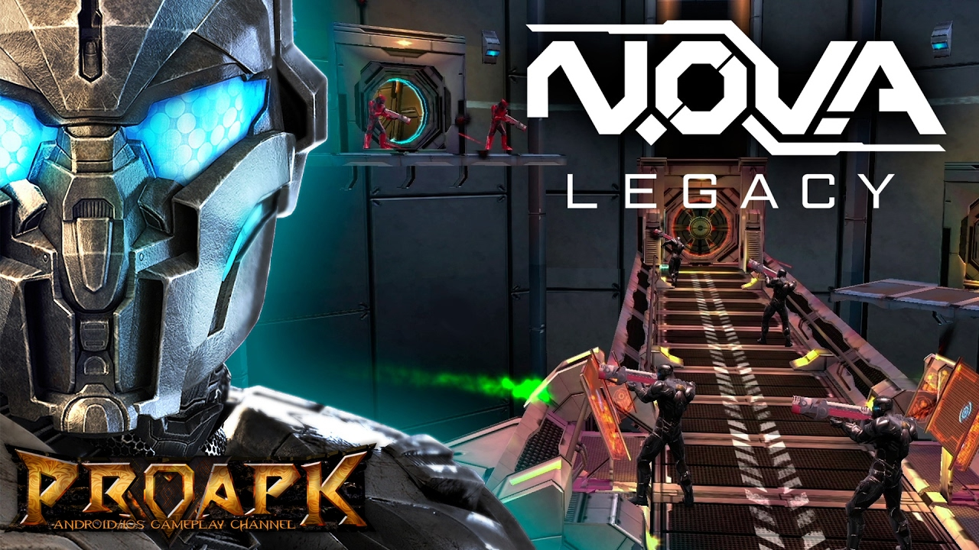
Preis
0,79$ 2,99$ 4,99 – 6,99$
Problem: Viele Spiele free to download

Slide 25
Break-Even
Hier Break-even mit 1$ 3$ 5$
30% platform
100$ apple app store

Slide 26
Marketing Budget/Kosten
Stärken + Schwächen
Flexibel erweiterbar
Hohe Stückzahlen müssen verkauft werden
Kaum Konkurrenz im Genre
Reichweite erzeugen
Graphik
Hohe Marketingkosten um Reichweite zu erzielen
Universelle App Kampagnen
Youtube
Am anfang hoher tagessatz dann stufenweise weniger

